Slide 1
Lesson 8 Driving Practice
Keys 4 Life 7th Edition 2020 Page 134- 142
Notes:
Blue title: Teacher slides
Black title : Slides to use with resource lessons
Video – optional trigger video

Slide 2

Activity 8.1
Why Practice?
Learning intention
List and explain preferred driver supervisor characteristics.
Road Safety Commission- Closer to home (0.30mins)
Notes:
Page 134-138
Remind students re: shared classroom environment agreements (i.e. safe and supportive); in addition to road trauma and procedure if material presented triggers an emotional response etc. [Road Trauma Council WA available].
Mention lesson learning intention
View video to engage students into the lesson and trigger discussion on the following slide.
Q. What key messages where highlighted in the video in relation to driving behaviours?
Emphasise that all driver’s have a responsibility to keep themselves and others safe when active as road users.
37 sec

Slide 3

Reflection… Learning New Skills
Think of a time when you learnt new skills….
What happened when you first started to learn the new skills?
Who helped you to learn the skills?
What skills or characteristics did the person helping you possess?
How did you improve?
What did you do when you had difficulty in mastering the skills?
Notes:
Page 134

Slide 4
Graffiti Talk
Notes:
Page 134

Slide 5
What a Supervisor Needs
a person who holds an instructors licence
or a person who is an instructor in a youth driver education course conducted or supervised by a body authorised by the Department of Transport for that purpose;
or a person who is authorised (licensed driver) to perform any driving of a kind for which the driving instruction is to be given* and has had that authorisation for a period of, or periods adding up to
(i) at least 2 years, in the case of driving of a moped;
or
(ii) at least 4 years, in any other case.
*This means that a person who is authorised to drive a ‘C’ class vehicle with an ‘A’ condition (automatic vehicle) cannot supervise a learner driver in a manual vehicle.
What qualities do they need?
Notes:
Ref page 30-31 Drive Safe Department of Transport
Patience
Time
Good communication
Confidence etc

Slide 6
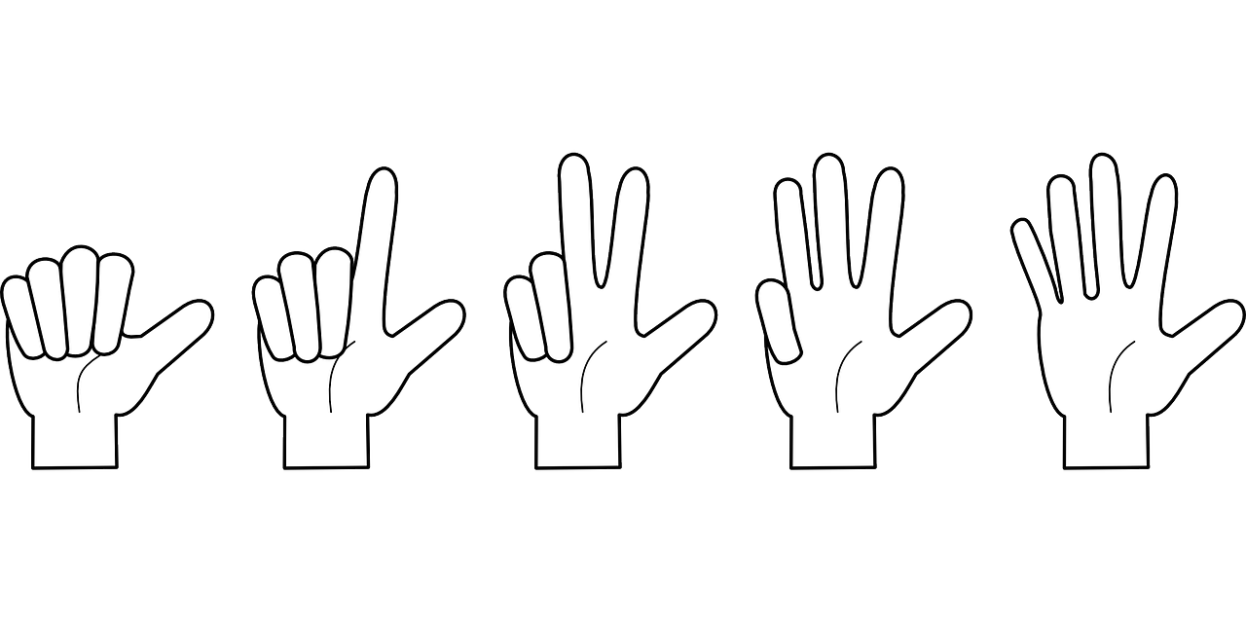
Fist of Five- Who could supervise you?
Include-
one agency/organisation/business
at least one non family member
one or more family member/s
Notes:
Who can supervise you? Keys 2 Drive, other local agencies

Slide 7
Did You Know?
1. Very few crashes happen when a learner driver is driving with a supervisor. Your learner driver is safest while they are being supervised.
2. Getting 120 hours of practice as a learner driver can reduce the crash risk on P plates by about 30%.*
3. For all learner drivers, the single most important protective factor is the hours of supervised driving experience they gain in real-world traffic situations before driving solo.
4. P plate drivers, in their first year of driving, are the most at risk group on the road. However, this crash risk decreases after the first 12 months of driving.
5. The main factors causing P plate drivers to crash are overconfidence and inexperience.
6. P plate drivers are more likely to be involved in a fatal crash at night due to their lack of experience and reduced visibility. Limiting night time driving when drivers first start on their P plates is an effective way to reduce the crash risk.
Notes:
Page 138

Slide 8

Journal Activities
Behind the Wheel Journal
TASK 9
Check out the conditions
page 12-13
Behind the Wheel Journal
TASK 8
Stop! Hazards ahead
Page 11
Behind the Wheel Journal
QUIZ 8
Driving in difficult conditions
page 27

Slide 9
Activity 8.2
Straight Talking
Learning intention
Define assertive communication and its applicability during the learning to drive process.
Road Safety Commission- Make eRideables Safe (0.15mins)
Notes:
Page 139-142
Remind students re: shared classroom environment agreements (i.e. safe and supportive); in addition to road trauma and procedure if material presented triggers an emotional response etc. [Road Trauma Council WA available].
Mention lesson learning intention
View video to engage students into the lesson and trigger discussion on the following slide.
Q. What key messages where highlighted in the video in relation to driving behaviours?
Emphasise that all driver’s have a responsibility to keep themselves and others safe when active as road users.
37 sec

Slide 10
What is assertive communication?
Assertive communication means being able to expressing your view in a way that is clear and direct, while still respecting others.
Assertive communication
requires a person to be honest about their rights, wants and needs while still considering the rights, wants and needs of others (CC Road Yr 9 p 17)
enables a person to express how they are feeling, why they are feeling this way and what they want to have happen (CC Drug Yr 9 p31)
increases a person’s capacity to handle difficult situations still allowing them to meet their needs while maintaining their relationships with others (CC Drug Yr 9 p31)
Notes:
References
Being assertive requires a person to be honest about their rights, wants and needs while still considering the rights, wants and needs of others (CC Road Yr 9 p 17)
Enables a person to express how they are feeling, why they are feeling this way and what they want to have happen (CC Drug Yr 9 p31)
Increases a person’s capacity to handle difficult situations still allowing them to meet their needs while maintaining their relationships with others (CC Drug Yr 9 p31)
More information about ‘assertive communication’ can be found:
Y9 Challenges and Choice Road Module 1 Resilience Education Topic 1 p15 and Topic 2 p 16
Year 9 road teachers resource print.indd (sdera.wa.edu.au)
Y8 Challenges and Choices Drug Module 1 Topic 3 Family Information Sheet Speaking Assertively p31
module-1-resilience-education-year-8.pdf (sdera.wa.edu.au)

Slide 11
Communication Styles- Assertive
So what you’re saying is…
I think…
ASSERTIVE
I would appreciate it if…
I feel…
I believe that…
I can see this is important to you. Next time could you…
Notes:
Activity 8.2 Straight Talking p 141
Activity Sheet Communication Styles p 141

Slide 12
Communication Styles- Passive
You have more experience than I do. You decide…
Nobody cares about my opinion…
PASSIVE
I just don’t know…
Notes:
Activity Sheet Communication Styles p 141

Slide 13
Communication Styles - Aggressive
AGGRESSIVE
That kind of logic is ridiculous…
You’re stupid if you think that will work…
Who cares what you think. I’m the one with he experience. We’ll do it my way.…
It’s going to be my way or not at all…

Slide 14
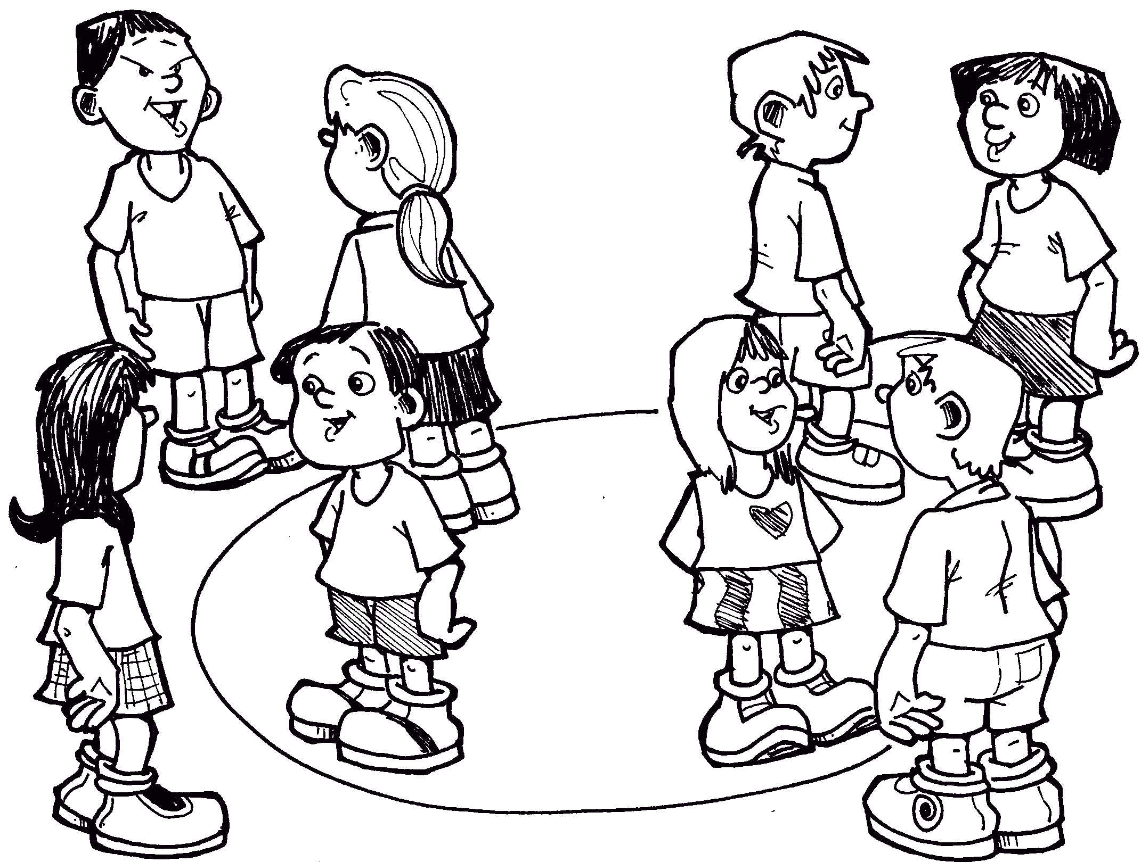
Role Play/ Circle Talk
Scenario 1
Your supervisor has been trying to teach you how to reverse park the car. You have had at least six goes but can’t get it right and now you are frustrated.
Your supervisor say, “oh for goodness sake. Just get it right and do it!”
What should you say?
Notes:
p139-140
Alternative to role play Circle Talk https://www.sdera.wa.edu.au/media/2355/challenges-choices-year-9-road-tls.pdf p67

Slide 15
Role Play/Circle Talk
Scenario 2
You live on a farm outside of town. Your supervisor thinks that driving your family into town will be good practice but you have to drive on a busy highway and don’t feel ready to do this just yet.
Your supervisor says, “If you can’t drive on that road now, you’ll never be able to.”
What should you say?
Notes:
p139

Slide 16
Role Play/Circle Talk
Scenario 3
A little kid has suddenly run out onto the road in front of your car. Your supervisor grabs the steering wheel and yells at you, “Stop the car. You’re going to kill someone.”
What should you say?
Notes:
p139

Slide 17
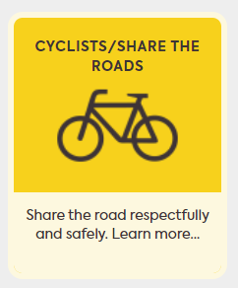
Road Rule: Crossing continuous white lines
Road Safety Commission Get Streetwise Cyclists- share the road (0.52mins)
Notes:
Ref Drive Safe DoT pages 55-56

Slide 18
For Teachers/Agencies only- Find out more links from resource:
From the Keys 4 Life teacher resource 2020 edition 7 Lesson 8
Access the Department of Transport’s website for up to date information about the Graduated Driver Training and Licensing system. Department of Transport Learn to Drive (My first licence) https://www.transport.wa.gov.au/licensing/learn-to-drive-my-first-licence.asp
School Drug Education and Road Aware Let’s Practise https://www.sdera.wa.edu.au/programs/keysfor-life/keys-for-life-teacher-resources/
Department of Transport Road rules theory test quiz https://www.transport.wa.gov.au/licensing/road-rules-theory-testquiz.asp

Slide 19
For Teachers / Agencies only: Website links from resource
From the Keys 4 Life teacher resource 2020 edition 7 Lesson 5
Students practise test questions with a parent or adult family member, using the eleven online sample quizzes at https://www.transport.wa.gov.au/licensing/road-rules-theory-test-quiz.asp
Your Secure Identity (https://www.transport.wa.gov.au/licensing/proof-of-identity.asp) describes the five (5) forms of identity required for the application process, of which:
FIND OUT MORE Department of Transport Road rules theory test quiz https://www.transport.wa.gov.au/licensing/road-rules-theory-test-quiz.asp

Slide 20
For Teachers / Agencies only- Quick links
Teachers register for the Portal by creating an access account at https://keys4life.ziparchive.com.au/.
Have your Keys4Life Access Number ready and use it to log in to: www.northsidelogistics.com.au
The Agency order form is available at: www.sdera.wa.edu.au/programs/keys4life/

