Slide 1
Lesson 7 More Ways to Reduce risk
Keys 4 Life 7th Edition 2020 Page 116- 130
Notes:
Blue title: Teacher slides
Black title : Slides to use with resource lessons
Video – optional trigger video

Slide 2

Activity 7.1
Speed and Stopping Distances
Learning intention
Explain the impact speed can have on safe driving
Predict stopping distances and what factors affect them
Road Safety Commission- Stopping Distance
Road Safety Commission -Auto Emergency Braking
Notes:
Page 116-123
Remind students re: shared classroom environment agreements (i.e. safe and supportive); in addition to road trauma and procedure if material presented triggers an emotional response etc. [Road Trauma Council WA available].
Mention lesson learning intention
View video to engage students into the lesson and trigger discussion on the following slide.
Q. What key messages where highlighted in the video in relation to driving behaviours?
Emphasise that all driver’s have a responsibility to keep themselves and others safe when active as road users.

Slide 3
Did you know?
The human body is vulnerable to collision forces in a crash.
Speeding is not just about driving faster than the speed limit, it is driving to the conditions (i.e. weather, visibility, traffic, road surface)
The higher the speed in a crash, the greater the force on impact and severity of injuries to the human body
Driving above the posted speed limit is illegal and will incur a fine and loss of demerit points.
Notes:
[KFL Teacher Resource, 2020 Edition, Page 114]

Slide 4
How fast can you stop?
Reaction distance
Breaking distance
Stopping distance
?
+
?
=
For every 5km/h increase in travelling speed in a 60km/h zone – the risk of injury in a crash doubles.
What factors could impact a driver’s ability to react and therefore increase the reaction distance travelled?
Why is it important for vehicle tyres to be maintained?
What else could influence the overall breaking distance of a vehicle?
Notes:
Factors impacting reaction distance: speed, fatigue, alcohol and other drugs, distractions (inside and outside the vehicle), inattention (i.e. consumption of food/drink, mobile phone use, engagement with technology etc), visibility (i.e. foggy weather).
Tyres are the only contact between the road and vehicle and it is essential they are maintained. Tyres must be appropriately inflated and with the correct tyre tread (more than 1.5mm) to ensure that the vehicle steers, stops and responds in an emergency as expected.
Factors impacting breaking distance: condition of vehicle and bakes, heavy vehicles (i.e. buses, trucks), vehicles towing, weather, road surface/conditions.
65km/h in a 60km/h zone = 2x more likely to be involved in a crash
70km/h in a 60km/h zone = 4x more likely to be involved in a crash
80km/h in a 60km/h zone = 32x more likely to be involved in a crash
[KFL Teacher Resource, 2020 Edition, Page 114]
The Physics of Speed (rsc.wa.gov.au)
This simulation game by the Road Safety Commission can be used to introduce the concepts of stopping distance. Potential for whole class viewing or small group/individuals depending on ICT availability.

Slide 5
Physics of Speed
Road Safety Commission: The Physics of Speed (game)
If you were going to share information about stopping distances to a learner driver, what tips would you give them to stay safe?
What did you notice about the stopping distances as the speeds increased?
Is the stopping distance for a particular speed fixed or will it vary? Why?
What areas other than around schools would benefit from having a 40km/h speed limit? Why?
Notes:
The Physics of Speed (rsc.wa.gov.au)
This simulation game by the Road Safety Commission can be used to introduce the concepts of stopping distance or as a debrief/follow up activity post How Fast Can you Stop Activity (KFL Teachers Resource, 2020 Edition page 119-120). Potential for whole class viewing or small group/individuals depending on ICT availability.

Slide 6
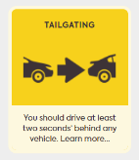
Two Second Rule
Behind the Wheel Journal
QUIZ #11
Speed
page 20
Road Safety Commission Get Streetwise Tailgating (0.57mins)
Why is it important to know the 2 second rule as a driver?
TAILGATING
Failure to follow a vehicle at a safe distance = $200 penalty and loss of 2 demerit points
When should a driver leave more than a 2 second gap?
What actions can a driver take to maintain a safe distance between vehicles?
What could a passenger say if they noticed an unsafe distance between vehicles?
Notes:
VIDEO: Get Streetwise – Tailgating: Get Streetwise - Tailgating RSC - YouTube
Tailgating - WA Road Rules (rsc.wa.gov.au)
Ref Department of Transport – Drive Safe Handbook pages 43 The ‘Two Second’ rule
Section 3.2: Following Distances
3.2.1 The Two Second Rule
3.2.2 How long does it take to stop your car?
3.2.3 How long does it take to stop a heavy vehicle

Slide 7


Journal Activities
Behind the Wheel Journal
TASK 6
Keeping a safe distance
page 9
Keys4Life Student Workbook
QUIZ 1
Speed
Page 4
Behind the Wheel Journal
TASK 5
Get ready to stop
Page 8
Behind the Wheel Journal
TASK 7
Check your speed
page 10

Slide 8
Activity 7.2
Driving is a Complex Task
Learning intention
Demonstrate how distractions impact driving
Road Safety Commission Life Toll - Roslind's story 30sec
Notes:
Page 124-130
Remind students re: shared classroom environment agreements (i.e. safe and supportive); in addition to road trauma and procedure if material presented triggers an emotional response etc. [Road Trauma Council WA available].
Mention lesson learning intention
View video to engage students into the lesson and trigger discussion on the following slide.
Q. What key messages where highlighted in the video in relation to driving behaviours?
Emphasise that all driver’s have a responsibility to keep themselves and others safe when active as road users.

Slide 9
Driving is a complex task activity
DRIVER
1. Sort the playing cards into suits from lowest to highest.
3. HAZARD CARD MANAGER
At different intervals and for a few seconds, show a hazard card to the driver.
Keep track of the cards the driver fails to read aloud.
2. SKILL CARD MANAGER
At different intervals and for a few seconds, show a skill card to the driver.
Keep track of the cards the driver fails to read aloud.
2. Read aloud all of the skill cards shown to you.
3. Read aloud all of the hazard cards shown to you.
4. Answer your passenger’s questions
Keep sorting the playing cards. If you stop sorting, you have stopped driving!
Observer (optional)
What did you notice about the driver’s ability to sort the playing cards throughout this activity?
4. PASSENGER
Ask the driver each of the questions on the sheet provided.
Keep track of the questions not answered by the driver.
Notes:
Progress the Driving is a Complex Task by introducing each component of the activity sequentially (i.e. build onto the driver task requirements within the activity).
1. Driving solo
2. Driving and acknowledging skill cards
3. Driving and acknowledging skill and hazard cards
4. Driving, acknowledging skill and hazard cards and answering passenger questions.
Observer can be an additional role if groups of 5 are generated within the classroom.

Slide 10
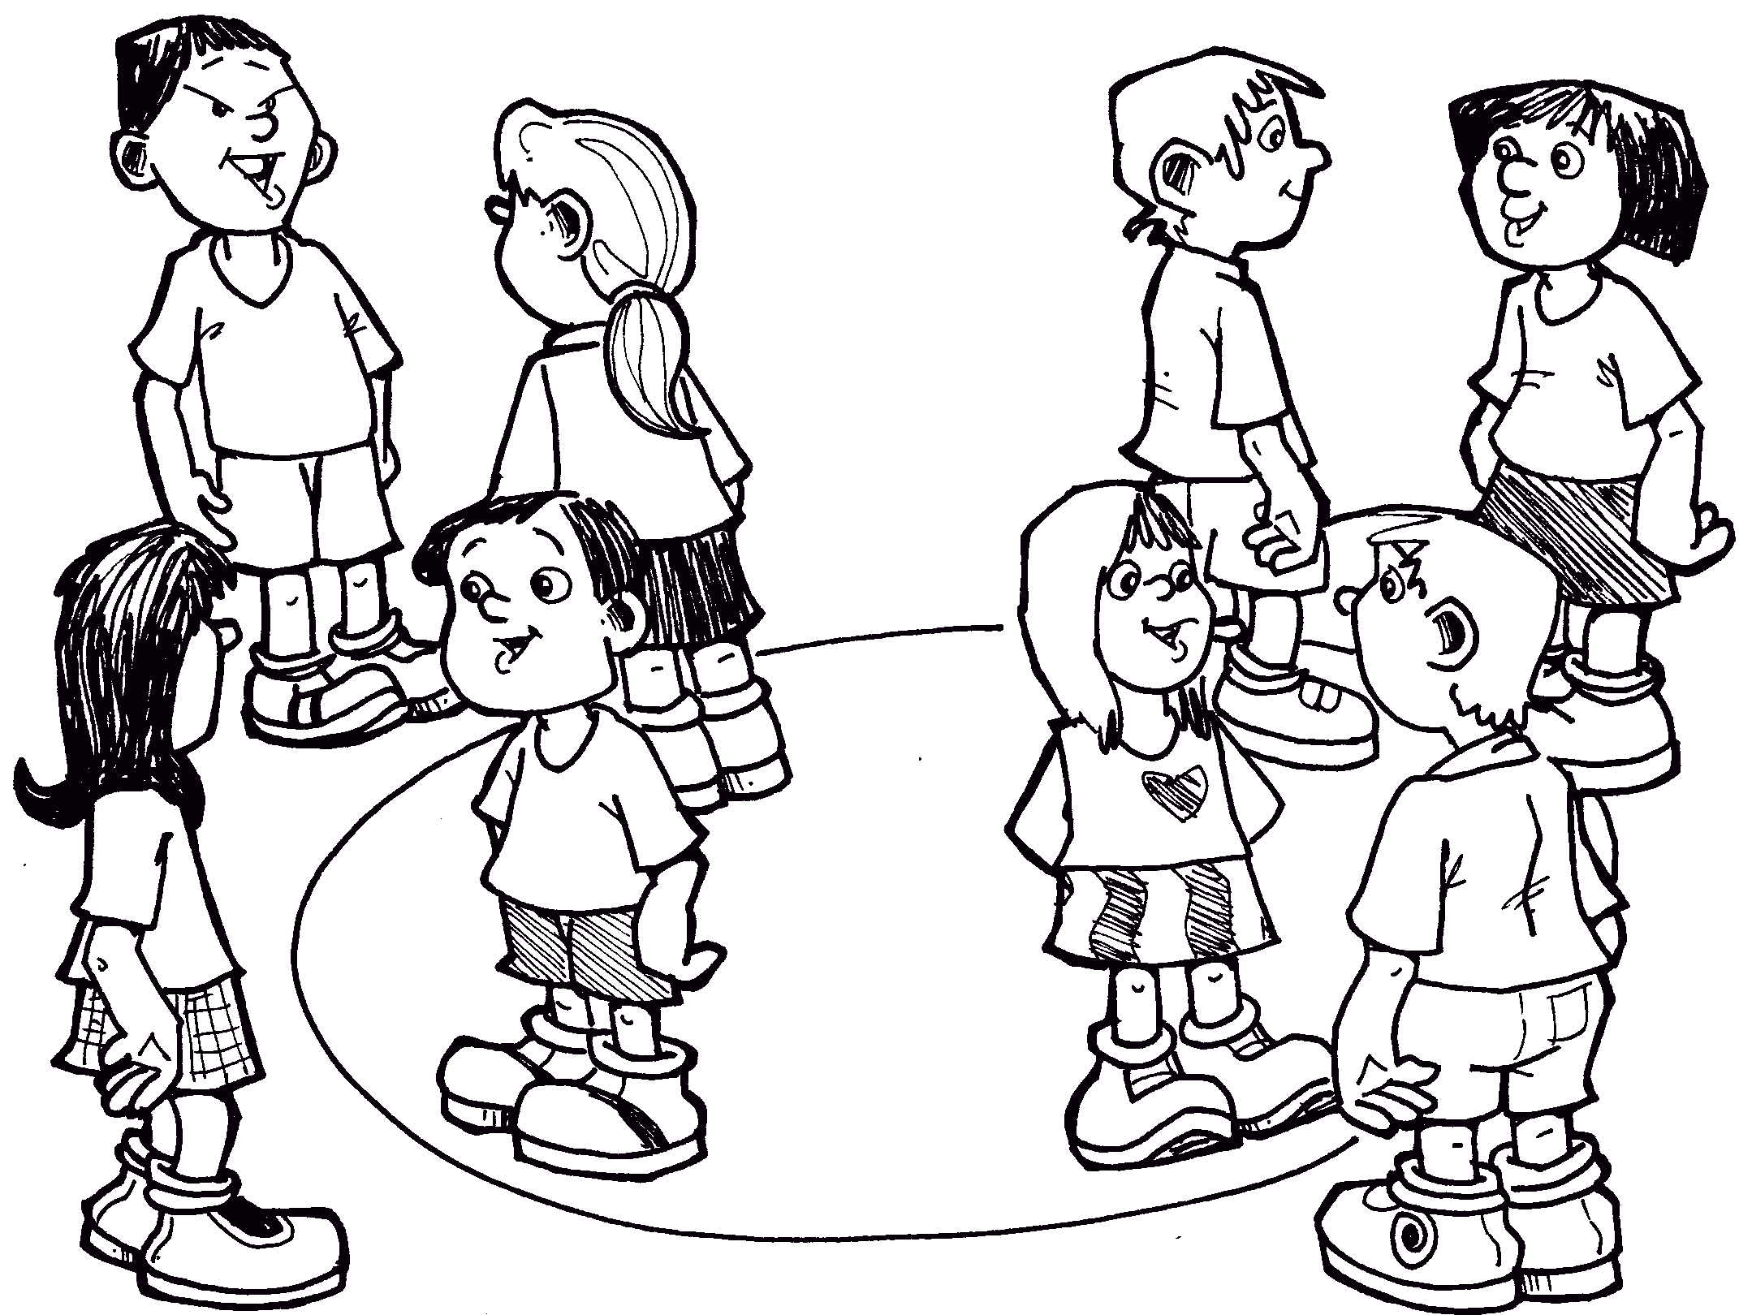
Circle Talk
1. What did you notice about your ability to concentrate and complete the task of sorting the playing cards?
2. Why do young drivers underestimate the number of things that must be managed to be a safer driver?
3. What could assist young drivers to be able to manage the number of things that must be managed by a safe driver?
4. Would the driver’s workload increase as the vehicle’s speed increases? Why?
5. Why is it important for passengers to understand the complexity of driving?

Slide 11
Journal Activities
Keys4Life Student Workbook
Driver Distraction
Page 4
Behind the Wheel Journal
TASK 4
Be Aware Of Distractions
Page 7

Slide 12
For Teachers/Agencies only- Find out more links from resource:
From the Keys 4 Life teacher resource 2020 edition 7 Lesson 7
Speed is clearly a major contributor to road crashes in WA https://www.rsc.wa.gov.au/Your-Safety/Behaviours/Speeding
Road Safety Commission Stopping distance (0.39 sec) https://www.rsc.wa.gov.au/Your-Safety/Behaviours/Speeding
https://www.youtube.com/watch?time_continue=7&v=XI35ll4eArI
Road Safety Commission Priorities – Speeding (0.32 sec) https://www.rsc.wa.gov.au/Campaigns/Speeding
Road Safety Commission Post-It Notes (0.31 sec) https://www.rsc.wa.gov.au/Campaigns/Speed
Road Safety Commission Enjoy the ride – Fast vs Slow (0.31 sec) https://www.rsc.wa.gov.au/Campaigns/Speed
Road Safety Commission Zero Heroes https://www.rsc.wa.gov.au/Campaigns/Zero-Heroes
Road Safety Commission Tyre maintenance https://www.rsc.wa.gov.au/Your-Safety/Vehicles/Light-Vehicles/Tyre-maintenance
Department of Transport Road rules theory test quiz https://www.transport.wa.gov.au/licensing/road-rules-theory-testquiz.asp

Slide 13
For Teachers / Agencies only: Website links from resource
From the Keys 4 Life teacher resource 2020 edition 7 Lesson 5
Students practise test questions with a parent or adult family member, using the eleven online sample quizzes at https://www.transport.wa.gov.au/licensing/road-rules-theory-test-quiz.asp
Your Secure Identity (https://www.transport.wa.gov.au/licensing/proof-of-identity.asp) describes the five (5) forms of identity required for the application process, of which:
FIND OUT MORE Department of Transport Road rules theory test quiz https://www.transport.wa.gov.au/licensing/road-rules-theory-test-quiz.asp

Slide 14
For Teachers / Agencies only- Quick links
Teachers register for the Portal by creating an access account at https://keys4life.ziparchive.com.au/.
Have your Keys4Life Access Number ready and use it to log in to: www.northsidelogistics.com.au
The Agency order form is available at: www.sdera.wa.edu.au/programs/keys4life/

