Slide 1
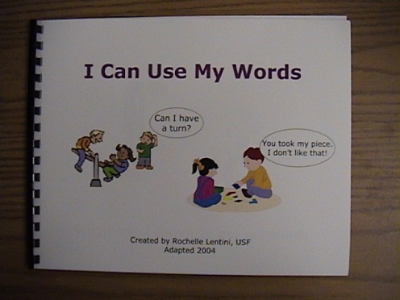

I Can Use My Words
Scripted Story Tips
For tips and guidelines about “Scripted Stories”, please begin by reading “Scripted Stories for Social Situations Tips” located in the Visual Strategies folder on your CD.
Please note that you can use real photographs with or instead of the line drawings for children that need this level of support. For instance, next to the line drawings, you can glue or Velcro a photograph of two children talking, the teacher talking to a child, a child who is upset, a child who is happy, etc.
Assembly Directions:
After printing on cardstock paper (or printer paper glued to a file folder for increased durability), bind the edge to form a book. If the child will use or handle the book, it might be helpful to laminate the pages prior to binding to increase durability. See next page(s) for “printing directions”.
Lentini, R., Vaughn, B. J., & Fox, L. (2005). Teaching Tools for Young Children
with Challenging Behavior. Tampa, Florida: University of South Florida,
Early Intervention Positive Behavior Support.

Slide 2
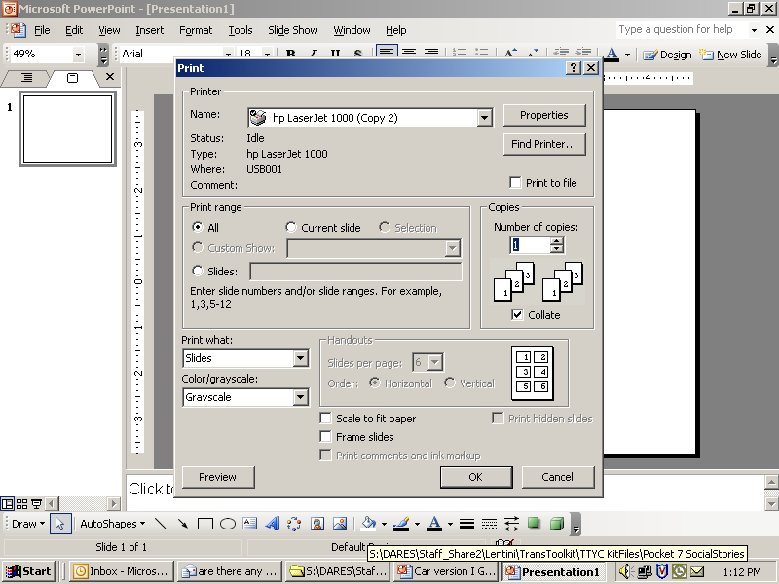

PRINT DIRECTIONS FOR FULL SIZE BOOK
Step 1:
Click on File & select Print
Step 2:
Select slides to print story
Type 4-17
Step 4:
Type # of copies
Step 3:
Select “slides”
Step 5:
Click OK
Lentini, R., Vaughn, B. J., & Fox, L. (2005). Teaching Tools for Young Children
with Challenging Behavior. Tampa, Florida: University of South Florida,
Early Intervention Positive Behavior Support.

Slide 3
PRINT DIRECTIONS FOR SMALL SIZE BOOK
Step 1:
Click on File & select Print
Step 2:
Select slides to print story
Type 4-17
Step 5:
Type # of copies
Step 4:
Select “2” slides per page
Step 3:
Change slides to
“handouts”
Step 6:
Click OK
Lentini, R., Vaughn, B. J., & Fox, L. (2005). Teaching Tools for Young Children
with Challenging Behavior. Tampa, Florida: University of South Florida,
Early Intervention Positive Behavior Support.

Slide 4


I Can Use My Words
Can I have
a turn?
You took my piece.
I don’t like that!
Created by Rochelle Lentini, USF
Updated 2004
Lentini, R., Vaughn, B. J., & Fox, L. (2005). Teaching Tools for Young Children
with Challenging Behavior. Tampa, Florida: University of South Florida,
Early Intervention Positive Behavior Support.

Slide 5
Sometimes I forget to use my words.

Slide 6
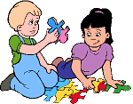

I can use words with pictures,
with written words,
or by talking.
My turn.
I need help.

Slide 7
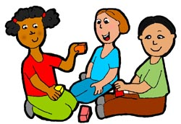
Can I play with you?
When I use words with people, they can understand what I am saying.

Slide 8

Sometimes I want something I can’t have, but it may be a choice later.
I can use my words and ask, “When can I use this?”
When can I
use this?
After lunch when we
come back outside.
Can I have
a turn?

Slide 9
Everyone is happy when I use my words.

Slide 10
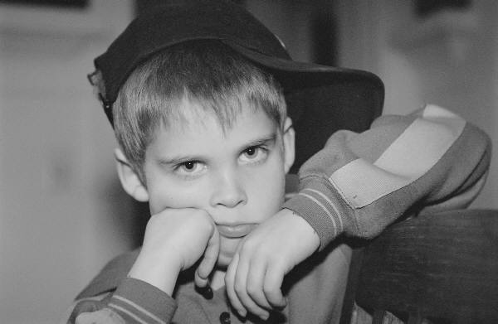
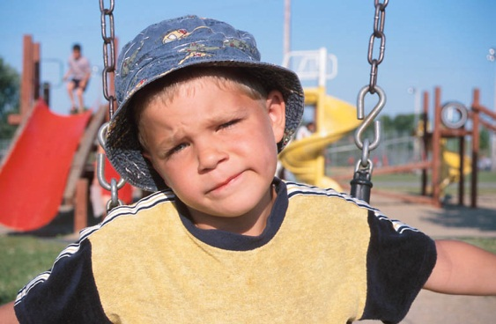
I can use words to tell people how I feel.
I say, “I am mad.”
or
“I don’t like that.”
I’m mad!
I don’t like that!

Slide 11
Say,
“I need help.”
Say,
“All done.”
My family and my teachers can help me remember to use words.

Slide 12
Help me please.
Help me please.
I can use words to ask for help.
I can say, “Help me please.”

Slide 13
You took my piece.
I don’t like that!
Can I play?
Can I see too?
People can understand me better if I use words.

Slide 14
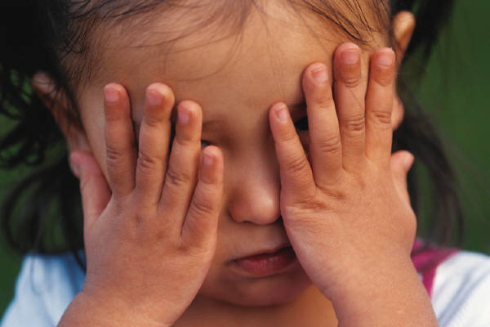

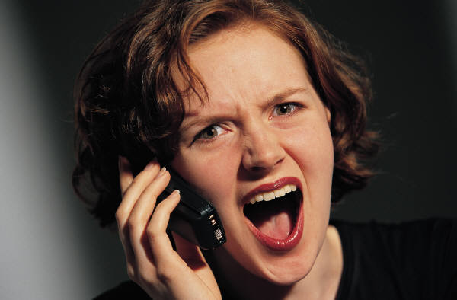
People can have a hard time listening to me when I whine and scream.

Slide 15
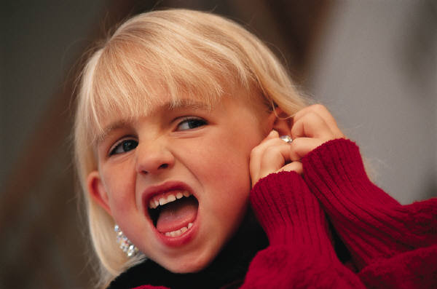
Whining and screaming can hurt people’s ears.

Slide 16
When I whine, scream, or cry,
people around me can get angry or upset.

Slide 17
Everyone is happy when I use my words.

