Slide 1
Lesson 5 Why Crashes Happen
Keys 4 Life 7th Edition 2020 Page 83-94
Notes:
Dark Blue title: Teacher slides- some will contain trigger videos
Black title : Slides to use with resource lessons
Video – optional trigger video

Slide 2

Activity 5.1
Driving Triangle
Learning intention
Understand the driving triangle and the factors that can contribute to a crash.
Road Safety Commission 154 Wrecking Ball 30s v3
Notes:
Keys for Life Resource Pages 86-88
Remind students re: shared classroom environment agreements (i.e. safe and supportive); in addition to road trauma and procedure if material presented triggers an emotional response etc. [Road Trauma Council WA available].
Mention lesson learning intention
View video to engage students into the lesson and trigger discussion on the following slide.
Q. What key messages where highlighted in the video in relation to driving behaviours that can make us safer road users?
Emphasise that all driver’s have a responsibility to keep themselves and others safe when active as road users.

Slide 3
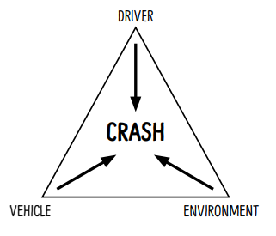
Explore the Driving Triangle
Did you know that 90% of crashes can be contributed to the drivers actions and behaviours.
Road crashes are the result of the interaction between the driver, the vehicle and the environment.
Think and discuss which driver characteristics and behaviours contribute to a crash.
What do you think you could do to reduce the DRIVER risk?
Notes:
Page 86

Slide 4
Characteristics and Behaviours That Can Contribute to Risk Taking and/or Accidents.
DRIVER | VEHICLE | ENVIRONMENTAL
Inexperience | Faulty brakes | Wet weather
Brainstorm at least 3 driving risks in the 3 areas.
These can be factors or behaviours
Lesson 5 – Why Crashes Happen
Notes:
Page 86

Slide 5

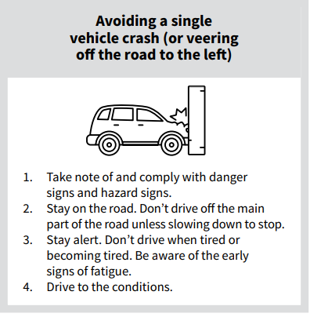
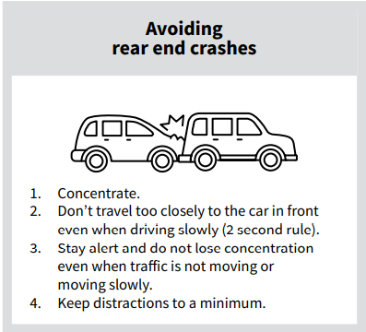
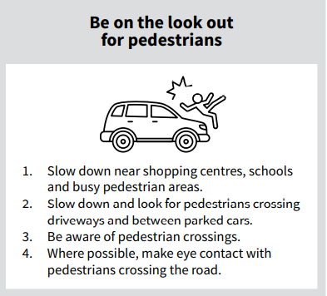
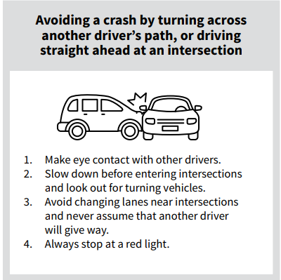
Tips for Avoiding Crashes
What are some strategies you can think of to help reduce the levels of risk for drivers, passengers and other road users?
Notes:
Page 88

Slide 6
Activity 5.2
Driving Risks
Learning intention
Explore the scenarios to determine driving risks and strategies to mitigate these.
Road Safety Commission Van Chat- Know before you tow (2.56 m)
Notes:
Keys for Life Resource Pages 89-94
Remind students re: shared classroom environment agreements (i.e. safe and supportive); in addition to road trauma and procedure if material presented triggers an emotional response etc. [Road Trauma Council WA available].
Mention lesson learning intention
View video to engage students into the lesson and trigger discussion on the following slide.
Q. What key messages where highlighted in the video in relation to driving behaviours?
Emphasise that all driver’s have a responsibility to keep themselves and others safe when active as road users.

Slide 7
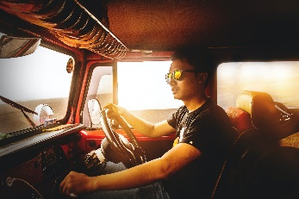
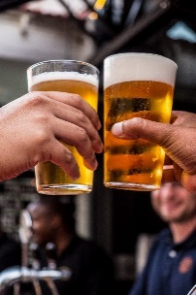
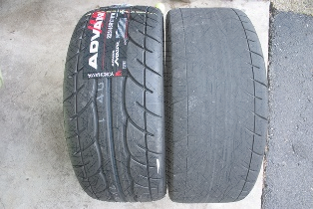

Driving Triangle Scenario
Look at the scenario.
On the risk continuum where do you think this risk lies.
Is it high, medium or low risk or somewhere in between?
Discuss with your group.
17 year old driver just got their licence.
Wet road at night
If we added a wild card factor to the driver like consuming
2 mid strength beers
before driving would this
change the risk? Discuss.
Bald tyres
LOW RISK
HIGH RISK
Notes:
Page 89
Whole class sample activity of the driver triangle

Slide 8
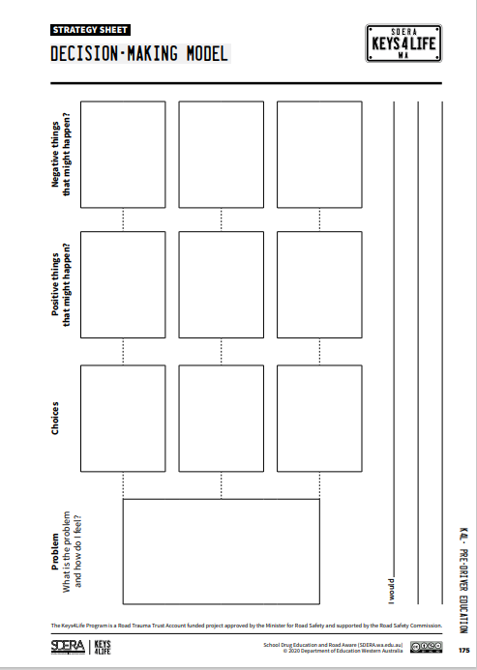
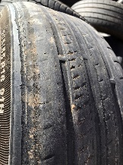
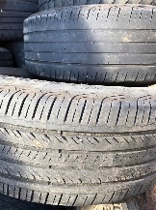


Decision Making
Using the scenario from the previous slide discuss reducing the risks using the
Decision Making Model
What could be done to the car to reduce risk?
What are some of the things the driver could do to reduce risk in this situation?
Can environmental factors be changed to reduce risk?
What could a driver do to reduce risk in different driving conditions?
Notes:
Page 89
Whole class sample activity of the driver triangle

Slide 9
Scenarios
Ask students to discuss the scenario created by their cards to determine the
associated risks
strategies that could reduce the level of risk to the driver, passengers and other road users
ENVIRONMENT
DRIVER
VEHICLE
Notes:
Page 88 The driving triangle
This activity can be completed by an individual student or students can be grouped in three, each taking one of the roles and developing the narrative around their card and concluding in the group bring it together to make the scenario.

Slide 10

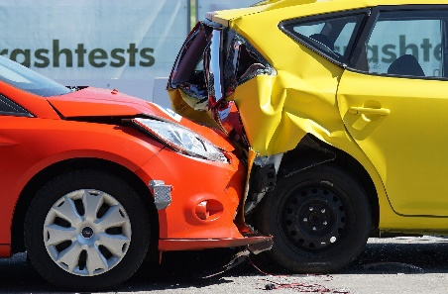
Rate The Risk
Using the scenarios developed in the last 2 slides… rate the risk (high or low risk)
DRIVER
CRASH
ENVIRONMENT
VEHICLE
WILD CARD
HIGH RISK
LOW RISK
Notes:
Page 86
After the discussion conduct the risk continuum
What situation would your cards create
Decide on the risk
Low – high risk
Rate the risk
Throw in the wild card, allow students to change on the risk meter- discuss changes

Slide 11
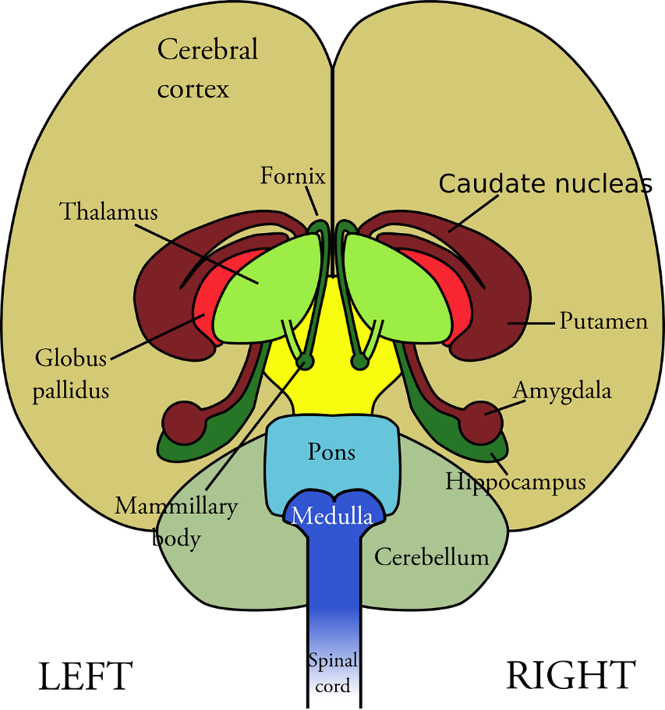
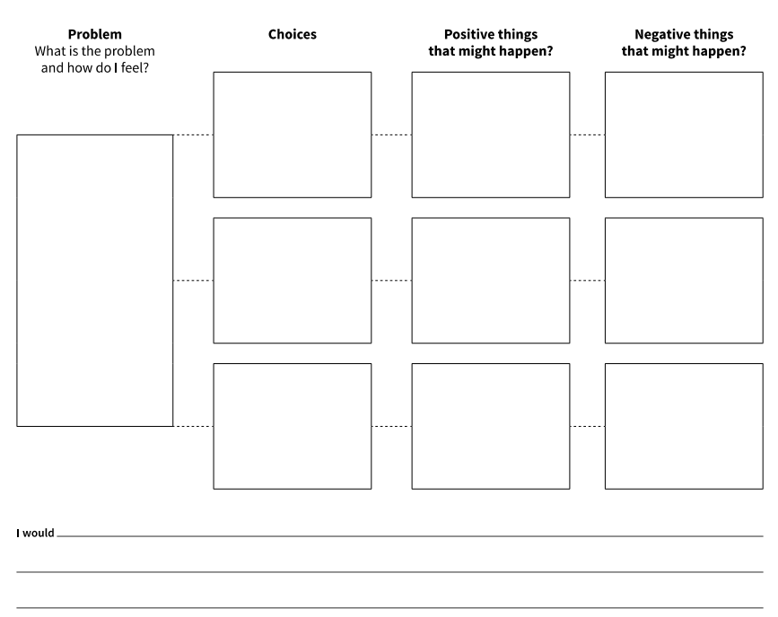
Change The Level of Risk
Choosing the highest risk scenario from the last slide, how would you make it less risky?
Decision Making Model
Cerebral Cortex = thinking, perceiving, producing and understanding.
Amygdala = memory, decision-making and emotional responses.
Notes:
What decisions could you change to make the situation safer
Their amygdala not their cerebral cortex is in control
Decision making model

Slide 12
Decision Making Model
Using the decision making model… create safer outcomes for the created scenarios
Notes:
Students may also put forward a situation that we may not perceive as safe but for them may minimise some out comes that they could feel more harmful to themselves.
This activity is value and attitude laden.
Reflection at the end of this activity is always important, taking time to discuss what could be possible consequences.

Slide 13
Unsafe vs Safe Decisions
Using a graffiti walk and the drive triangle elements (environment, person, vehicle & wild card) get students to brainstorm safe and unsafe choices that young people make when driving (i.e. peer pressure)
ENVIRONMENT
VEHICLE
DRIVER
WILD CARD
Notes:
Extension Activity
What would make a young person choose unsafe over safe
Peer pressure
Boredom
Curiosity
Lack of education

Slide 14

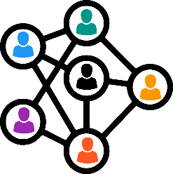


Road Crashes - Consequences
When a road crash happens, there are subsequent consequences that occur. These can be grouped into five different types of consequences.
Legal
Types of consequences
Social
Emotional
Are these consequences relevant to just the vehicle occupants (i.e. driver, passenger?
Who else can be impacted by a crash?
Financial
Physical
Notes:
Using the information form the last slide regroup consequences using the model in the slide

Slide 15
Road Crashes - Consequences
When a road crash happens, there are subsequent consequences that occur. These can be grouped into seven different types of consequences.
Figure 26.3 Strong Spirit Strong Mind: The Seven Areas used with permission by
Casey, W (2014) Strong Spirit Strong Mind Model – Informing Policy and Practice in Chapter 26 in Dudgeon P, Milroy H & Walker R. 2014, Working Together: Aboriginal and Torres Strait Islander Mental Health and Wellbeing Principles and Practice. Canberra: Australian Government Department of the Prime Minister and Cabinet, 2nd ed., pp.449-458.
Notes:
Using the information form the last slide regroup consequences using the model in the slide
Alternative model for indigenous class members: The 2nd Edition of Working Together: Aboriginal and Torres Strait Islander Mental Health and Wellbeing Principles and Practice (eds Pat Dudgeon, Helen Milroy and Roz Walker). Published in 2014, Working Together was funded by the Australian Government Department of the Prime Minister and Cabinet, Telethon Kids Institute/Kulunga Aboriginal Research Development Unit in collaboration with the University of Western Australia.
www.telethonkids.org.au%2Fglobalassets%2Fmedia%2Fdocuments%2Faboriginal-health%2Fworking-together-second-edition%2Fworking-together-aboriginal-and-wellbeing-2014.pdf&clen=14853245&chunk=true
Casey W, Keen J. Strong Spirit Strong Mind: Aboriginal Alcohol and other drugs Worker Resource: A Guide to working with our people, families and communities. Government of Western Australia, Drug and Alcohol Office. Perth, Western Australia, 2005.
The Seven L’s or Seven Areas Model
Grief and Loss – (Loss) Many Aboriginal people experience daily grief and loss on a daily basis: they might use alcohol and other drugs to cope with: Family and friends passing away• Loss of family connections due to stolen generation issues • and intergenerational trauma Family members being in jail• Painful events within family and community
• Country – (Land) Alcohol and other drug use can prevent people from looking after their country. Some people do not have access to traditional lands or sacred sites and might use substances to cope with being lonely for country.
Aboriginal Law and Culture – (Law) Alcohol and other drug use can lead to: Not keeping social and cultural obligations • Breaking Aboriginal Law or cultural rules: this can cause • further stress Not respecting, learning or teaching culture
Health – (Liver) This refers to all of the health problems caused by alcohol and other drug use. This can include: Body Liver and heart disease Cancers Blood borne viruses, i.e. Hep C and HIV STDs Diabetes Mind and Spirit Depression Anxiety Drug induced psychosis Inner spirit
Family and Community Relationships – (Lover) This includes negative impacts on family and community relationships, including: • • • Fighting – verbal and physical Neglect Stress and worry
Money, Work and Study – (Livelihood) Spending too much money on alcohol and other drugs can lead to other problems such as: • • • • • Can’t buy food for the family Can’t pay bills Asking family/friends for money Unemployment Not finishing school
Problems with the Whiteman’s Law – (Legal) Alcohol and other drug use can lead to problems with the law such as: • • • • • • Drug charges Committing crimes – i.e. assault, theft Manslaughter Drink driving Fines Jail

Slide 16
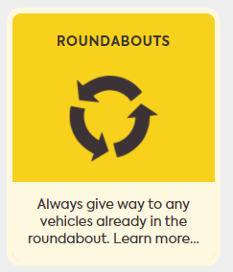
Road Rule: Merging
Road Safety Commission Streetwise Roundabouts
Notes:
Ref Drive Safe DoT pages 63-65
Indicators/signals at roundabouts
Roundabouts have several exit points. Enter a roundabout only when there is a safe gap in the traffic and no risk of a crash.
Turning Left
When turning left at a roundabout, approach from the left lane, indicate/signal left, stay in the left lane and exit in the left lane.
Turning Right
When turning right at a roundabout, approach from the right lane, indicate/ signal right and stay in the right lane. Indicate/signal left, if practicable, as you are passing the exit before the one you wish to use. When leaving the roundabout, exit in the right lane.
Going Straight Ahead
You do not need to indicate/ signal when you are approaching a roundabout if you are going straight ahead. Unless the road markings show otherwise, approach the roundabout from either the left or right lane and drive in that lane throughout the roundabout.
Indicate/signal left if practicable, as you are passing the exit before the one you wish to use. Exit in the same lane in which you entered (that is, exit in the left lane if you entered in the left lane or the right lane if you entered the roundabout in the right lane).
U Turns(complete 360)
If you are using the roundabout to make a full turn (‘U’ turn), that is, to turn back into the same road from which you entered the roundabout, follow the instructions for turning right.
Generally, take care when you drive in a roundabout, especially when you are changing lanes and leaving it. Watch out for: vehicles that are leaving the roundabout; vehicles that are making a full turn; and bicycles, long vehicles and motorcycles.

Slide 17
For Teachers/Agencies only- Find out more links from resource:
From the Keys 4 Life teacher resource 2020 edition 7 Lesson 5
FIND OUT MORE Road Safety Commission Campaigns https://www.rsc.wa.gov.au/Campaigns
FIND OUT MORE Department of Transport Road rules theory test quiz https://www.transport.wa.gov.au/licensing/road-rules-theory-test-quiz.Asp
FIND OUT MORE Road Safety Commission Campaigns https://www.rsc.wa.gov.au/Campaigns

Slide 18
For Teachers / Agencies only: Website links from resource
From the Keys 4 Life teacher resource 2020 edition 7 Lesson 5
Students practise test questions with a parent or adult family member, using the eleven online sample quizzes at https://www.transport.wa.gov.au/licensing/road-rules-theory-test-quiz.asp
Your Secure Identity (https://www.transport.wa.gov.au/licensing/proof-of-identity.asp) describes the five (5) forms of identity required for the application process, of which:
FIND OUT MORE Department of Transport Road rules theory test quiz https://www.transport.wa.gov.au/licensing/road-rules-theory-test-quiz.asp

Slide 19
For Teachers / Agencies only- Quick links
From the Keys 4 Life teacher resource 2020 edition
Teachers register for the Portal by creating an access account at https://keys4life.ziparchive.com.au/.
Have your Keys4Life Access Number ready and use it to log in to: www.northsidelogistics.com.au
The Agency order form is available at: www.sdera.wa.edu.au/programs/keys4life/

