Slide 1
Lesson 1 Learn To Drive
Keys 4 Life 7th Edition 2020 Page 17-30
Notes:
Blue title: Teacher slides
Black title : Slides to use with resource lessons
Video – optional trigger video

Slide 2
Activity 1.1 Exploring the Keys4Life program. Page 21-24
Learning intention
Articulate the requirements for sitting the theory test at school as a conclusion to the Keys4Life program
Department of Transport: How to reduce your crash risk for novice drivers speed
Notes:
Remind students re: shared classroom environment agreements (i.e. safe and supportive); in addition to road trauma and procedure if material presented triggers an emotional response etc. [Road Trauma Council WA available].
Mention lesson learning intention
View video to engage students into the lesson and trigger discussion on the following slide.
Q. What key messages where highlighted in the video in relation to driving behaviours?
Emphasise that all driver’s have a responsibility to keep themselves and others safe when active as road users.

Slide 3
Brainstorm: Advantages and Disadvantages of getting a drivers licence
Buy my OWN car
Freedom from parents
Advantages | Disadvantages
Cost to run a car
The number of hours I need to do
Responsibility of being a driver
Access to a supervisor
Notes:
Page 21
Some answers for debate☺
Slide solutions

Slide 4
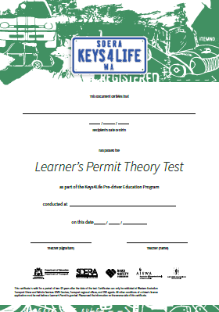
Keys4Life – what is it?
Notes:
Page 21
KEYS4LIFE – WHAT IS IT?
Pre-driver education for 15 to 18 year olds
Pre-learning to Learner’s Permit - but is not the actual Learner’s Permit
Delivered by over 250 schools, 600 teachers and 60 agencies, across WA
Over 23,500 students participate every year (ie almost 60% of all learner drivers)
Commenced in 2004 and funded by Road Safety Commission
Endorsed by the School Curriculum and Standards Authority and by Transport.

Slide 5
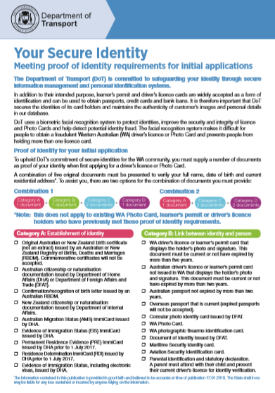
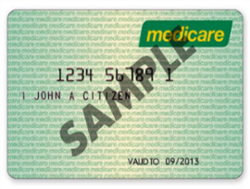
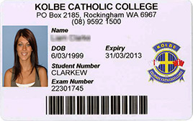
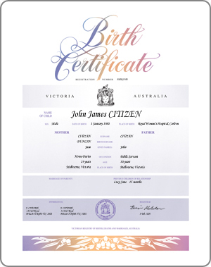
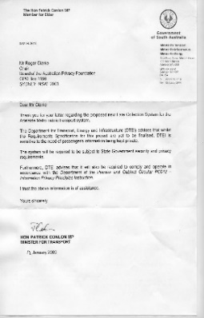
Identity Documents
5 forms of identity documents are needed to get your Learner’s Permit.
Your CERTIFICATE is a Category C form of identity.
Department of Transport https://www.transport.wa.gov.au/mediaFiles/licensing/LBU_FS_YourSecureID.pdf

Slide 6
Students must complete one workbook
10 tasks, safety pledge, 10 quizzes | 10 tasks, 2 safety pledges, 5 quizzes
Print copy and Writable pdf
Print copy and Writable pdf
Notes:
STUDENT JOURNAL OR WORKBOOK
Remind students:
‘No journal (or workbook) completed means no test’.
From lesson 1, teachers must ensure students complete all tasks and record this on the KFL Class Record.
The journal (or workbook) is compulsory :
Student journal is completed at home (so doesn’t suit all students) – available in print or as a writable pdf
Student workbook is completed in class (preferable for some students) – available in print or as a writable pd

Slide 7
Your Responsibilities
Complete a journal or workbook
Attend and participate in 10 lessons
(or catch up if sick)
Be 15 years or older to sit the learners permit theory test at school
15
lesson attendance + workbook + age = test
Notes:
Page 21

Slide 8
Activity 1.2 The WA Graduated Driver Training and Licensing (GDT&L) system. Page 25-30
Learning intention
Explain the 6 steps in the WA Graduate Driver Training and Licensing system
Explain the requirement for supervisor drivers
Department of Transport: how to reduce your crash risk for novice drivers- seatbelts
Notes:
Remind students re: shared classroom environment agreements (i.e. safe and supportive); in addition to road trauma and procedure if material presented triggers an emotional response etc. [Road Trauma Council WA available].
Mention lesson learning intention
View video to engage students into the lesson and trigger discussion on the following slide.
Q. What key messages where highlighted in the video in relation to driving behaviours?
Emphasise that all driver’s have a responsibility to keep themselves and others safe when active as road users.

Slide 9
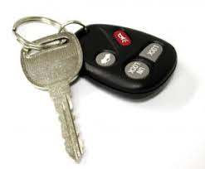
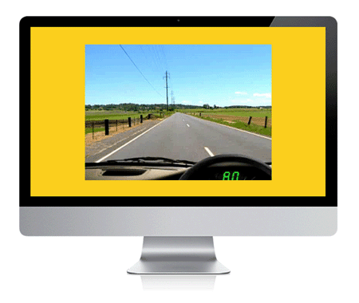
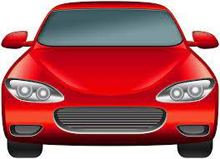
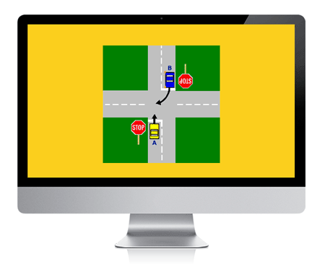
Keys4Life and the WA Licensing System
KFL
Step 1
Step 2
Step 3
Step 4
Step 5
Step 6
Lessons and test
Learner’s Permit
(L plates)
Learn to drive
(Log book)
Hazard Perception
Test (HPT)
Gain experience
(Log book)
Practical driving Assessment (PDA)
Provisional Licence
(P plates)
Notes:
Page 26 and 30

Slide 10
What things do I need to know while on my learners permit?
BAC 0.00%
No driving in Kings Park
Can tow a trailer, boat etc. when ready
Can drive on freeway when ready
Maximum speed allowed is 100km where signed
Must have a supervisor in front passenger seat at all times
Can carry passengers other than supervisor
Must carry learners permit at all times when driving
Must log hours – minimum of 50 required including 5 hours of night time driving
Notes:
Ref page 30
Slide solutions

Slide 11
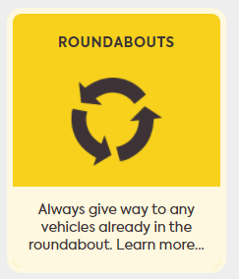
Road Rule: Merging
Road Safety Commission Get Street Wise - Roundabouts
Notes:
Where two lanes merge into one, the vehicle in front has right of way.
If there are multiple marked lanes, and one ends, give way to the vehicles in the lane you are moving into.
Remember:
Always use your indicator to signal your intentions to other drivers when merging.
Keep a safe distance between your vehicle and the vehicle in front of you and take turns to merge if there are long lines of merging traffic.
Try to match the legal speed of the road you’re merging into, but don’t speed up to get your vehicle ahead of others.

Slide 12
Find out more
From the Keys 4 Life teacher resource 2020 edition 7 Lesson 1
FIND OUT MORE Road Safety Commission Campaigns https://www.rsc.wa.gov.au/Campaigns
FIND OUT MORE Department of Transport Road rules theory test quiz https://www.transport.wa.gov.au/licensing/road-rules-theory-test-quiz.Asp
FIND OUT MORE Road Safety Commission Campaigns https://www.rsc.wa.gov.au/Campaigns

Slide 13
Website links from resource
From the Keys 4 Life teacher resource 2020 edition 7 Lesson 1
Students practise test questions with a parent or adult family member, using the eleven online sample quizzes at https://www.transport.wa.gov.au/licensing/road-rules-theory-test-quiz.asp
Your Secure Identity (https://www.transport.wa.gov.au/licensing/proof-of-identity.asp) describes the five (5) forms of identity required for the application process, of which:
FIND OUT MORE Department of Transport Road rules theory test quiz https://www.transport.wa.gov.au/licensing/road-rules-theory-test-quiz.asp

Slide 14
For teachers /agencies only
From the Keys 4 Life teacher resource 2020 edition 7
Teachers register for the Portal by creating an access account at https://keys4life.ziparchive.com.au/.
Have your Keys4Life Access Number ready and use it to log in to: www.northsidelogistics.com.au
The Agency order form is available at: www.sdera.wa.edu.au/programs/keys4life/

